Slide 1




DEPLOYMENT
OF
AMAZON WEB SERVICES

Slide 2
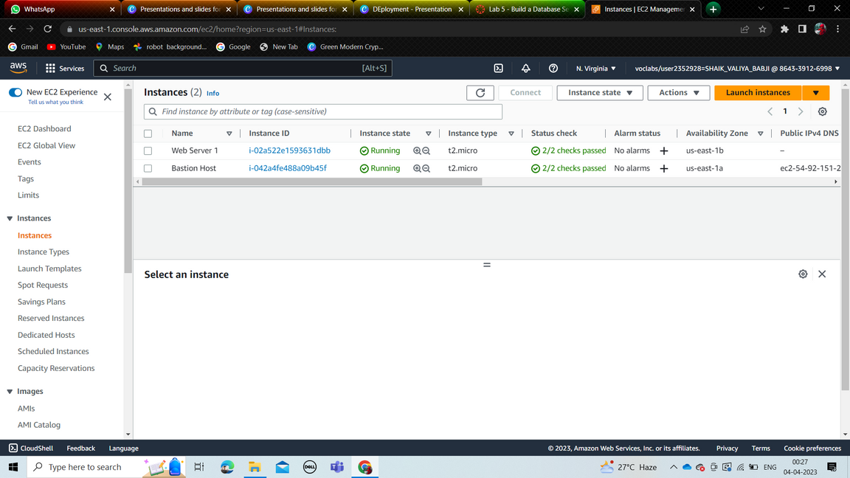
Amazon EC2
1 - > Search for EC2 service.
2 - > Click on launch instance.
3 - > Configure the following
1 - > Name of your instance
2 - > Select AMI
3 - > Select instance type
4 - > Add a key pair
5 - > Network settings
1 - > Select VPC
2 - > Create security group
4 - > Click on launch instance.

Slide 3
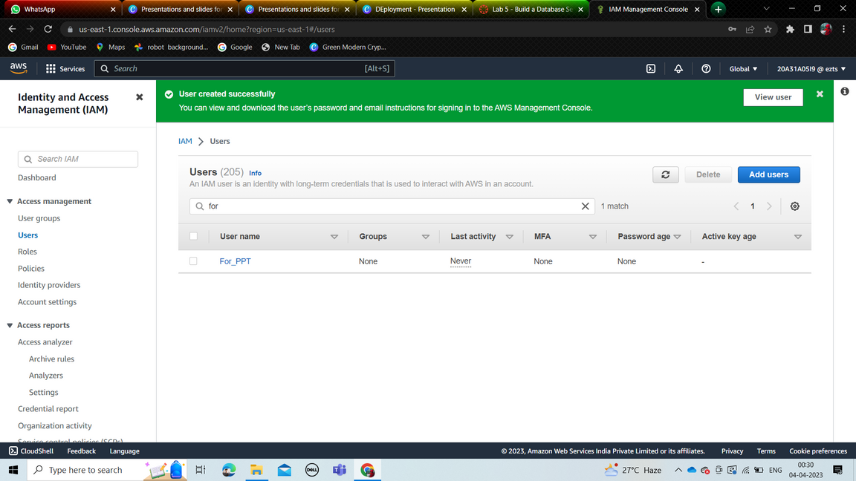
Amazon IAM
creation of users
1 - > Search for IAM service.
2 - > Select users from left menu.
1 - > Enter name of the user.
2 - > Tick below option.
3 - > Set custom password.
3 - > Next select group to add user.
or select attach policies to add .
permissions.
4 - > Create user.

Slide 4
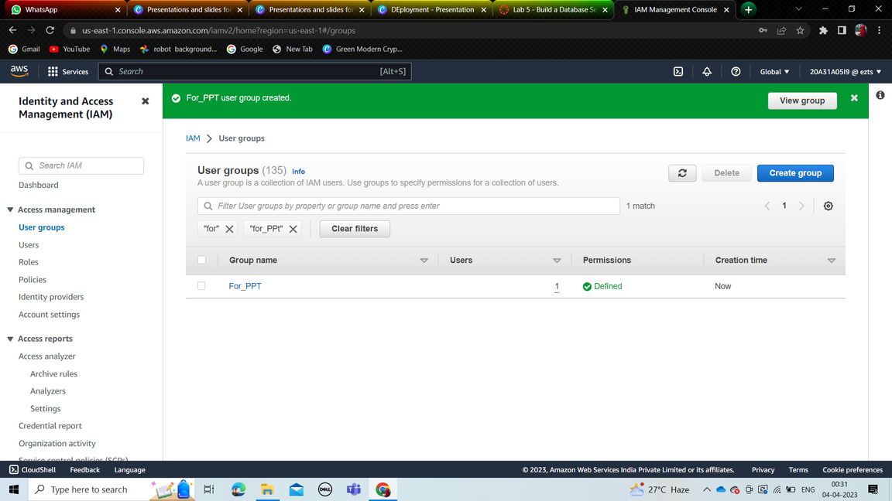
Amazon IAM
creation of groups
1 - > Search for IAM service.
2 - > Select groups from left menu.
1 - > Enter name of the group.
2 - > You can add users..
3 - > Attach policies.
4 - > Create group.

Slide 5
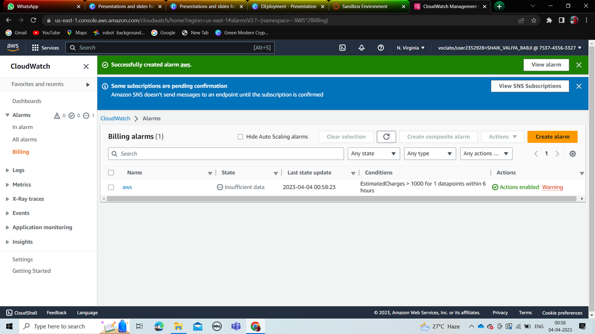
Amazon Cloud Watch
1 - > Search for cloudwatch service.
2 - > Select billing in left menu.
3 - > Create alarm.
1 - > Select curreny type.
2 - > select threshold type.
3 - > Enter threshold value.
4 - > Add notification
1 - > Select in alarm.
2 - > Create sns topic.
1 - > Enter topic name.
2 - > Enter email.
3 - > Create topic.
5 - > Add name and description.
6 - > Preview and Create.

Slide 6
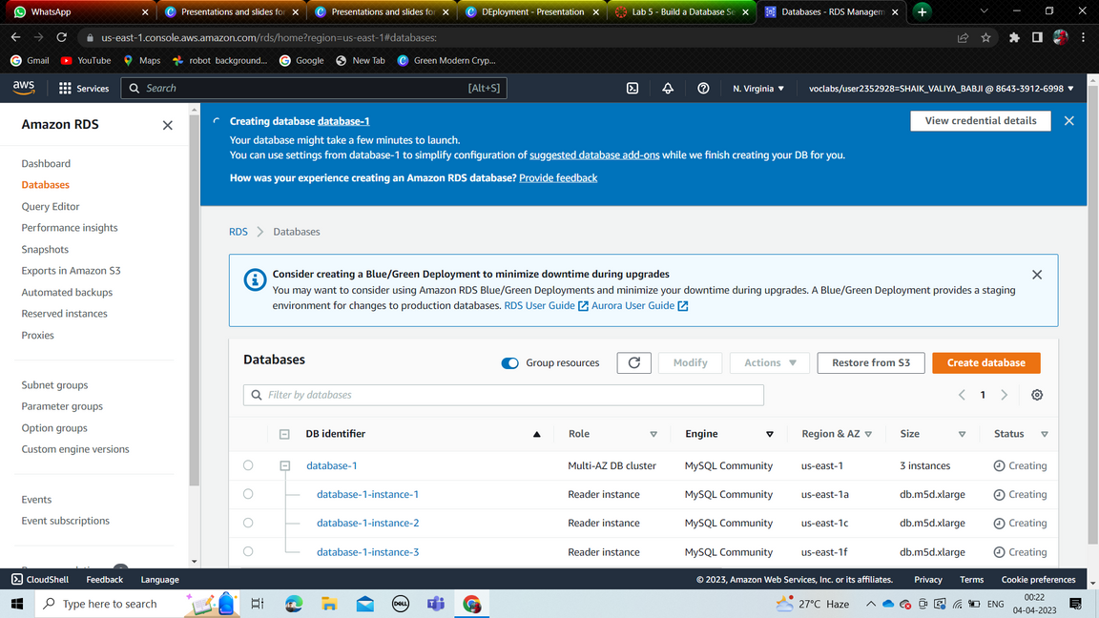
Amazon RDS
1 - > Search for RDS service.
2 - > Select create database.
3 - > Select language.
4 - > Add username and password
5 - > Select storage type and capacity
5 - > connectivity
1 - > Select vpc.
2 - > Add security group.
6 - > Create database.

Slide 7
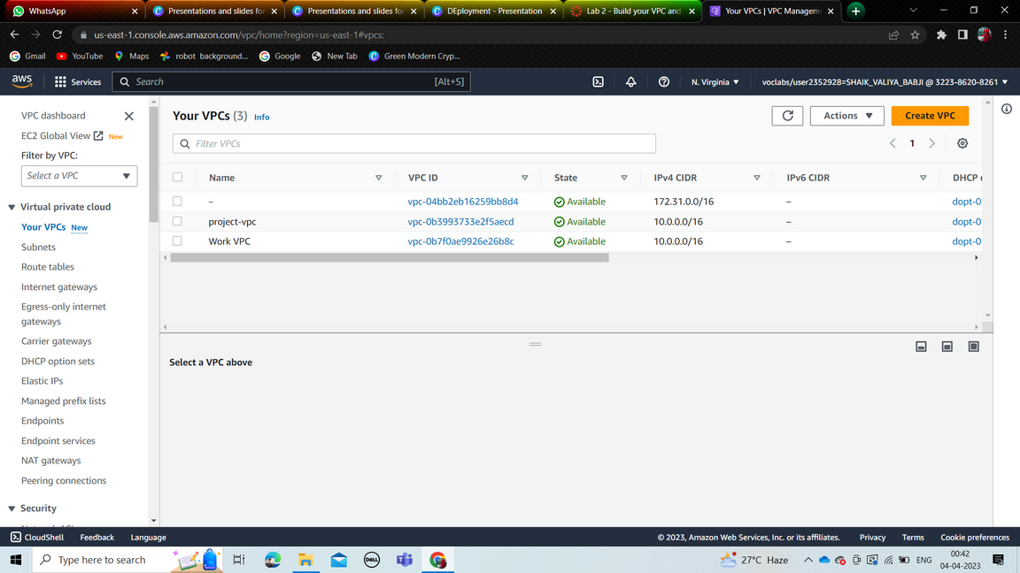
Amazon VPC
1 - > Search for VPC service.
2 - > Click create vpc.
1 - > Enter vpc name.
2 - > Select availability zones.
3 - > Select no of public subnets.
4 - > Select no of private subnets.
5 - > Select NAT gateway.
6 - > Create.
3 - > Select security groups.
1 - > Create security group.
2 - > Enter name and select vpc.
3 - > Add rules.
4 - > Create.

Slide 8
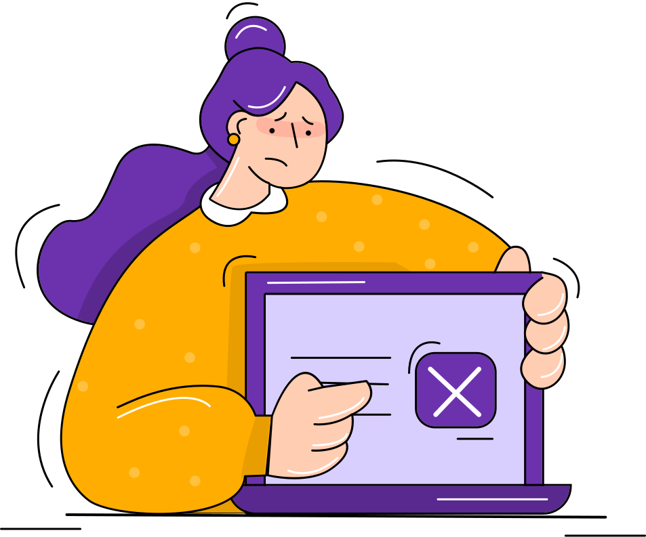
THANK YOU

